Slide 1


Identifiers
Identifiers
(names)
Notes:
标识符-P35， Chapter 2.4
Not specified in Processing

Slide 2
Objectives:
Java identifiers definition, rules and conventions
Java variables: declaration and assignment
Numerical literals:
byte
short
int
long
float
double

Slide 3
Identifiers: Definition and Rules
Identifiers are the names that identify the elements such as classes, methods, and variables in a program.
An identifier is a sequence of characters that consists of letters, digits, underscore (_), and dollar sign ($).
An identifier must start with a letter, an underscore (_) or a '$‘. It cannot start with a digit.
Uppercase and lowercase letters are considered to be different characters. Identifier can be of any length.

Slide 4
Identifiers: Rules and Examples
An identifier cannot be a reserved word (Java Keywords).
You’ll need identifiers to reference them elsewhere in your program:
int myVariable = 5; // Declaration
myVariable = myVariable + 1; // Using the variable
Examples:
Legal: myVariable, my_class, my4Var
Illegal: 4myVariable, my class, my!Var, @#$myClass

Slide 5
Java Naming Conventions:
Choose meaningful and descriptive names: LinkedList, compareTo
area = PI * radius * radius;
Variables & Methods start with lower case letters: radius, computeArea.
Classes start with upper case letters: Person.

Slide 6

Java Naming Conventions: Contd.
Use Camel notation: myVariable, MyClass.
Constants: Capitalize all the letters in a constant, and use underscore to connect words. Example:
PI
MAX_VALUE

Slide 7
Variables:
Variables are used to represent (store) values that may change in the program.
They represent pieces of information
Variables come in different types:
int and long store integers
char stores single characters (‘a’)
float and double store decimal values

Slide 8
Variable: Declaration
Java requires you to declare a variable before you use it
This tells Java what behavior to expect from that variable
Declare a variable (tell the compiler that you’re going to use it) by writing the type, followed by the name:
int x; // Declares an integer variable x
double pi; // pi holds a fractional number

Slide 9
Variable: Declaration is must !
All Java variables must have a declared type.
A variable’s type determines:
What kind of value the variable can hold.
How much memory to reserve for that variable.
Example:
char letter; int i;
double area; String s;

Slide 10
Variable: Role in a program
In a program, the variables store data.
Primitive type: variables store single piece of data:
char letter = 'A';
Object or reference type: variables store multiple pieces of data (ex: a String is a sequence of potentially multiple characters):
String text = "ABCDEFG";

Slide 11
Number Literals
A literal is a constant value that appears directly in the program.
Example: 34, 1000000, and 5.0 are literals in the following statements:
int i = 34;
long x = 1000000;
double d = 5.0;

Slide 12
Integer Literals
An integer literal can be assigned to an integer variable as long as it can fit into the variable.
Example: the following statement will result in a compiler error, because 1000 cannot be stored in a variable of the byte type (Range: -128 to 127).
byte b = 1000;
To denote an integer literal of the long type, append it with the letter L or l. (L preferred over l to avoid confusion with digit 1)

Slide 13
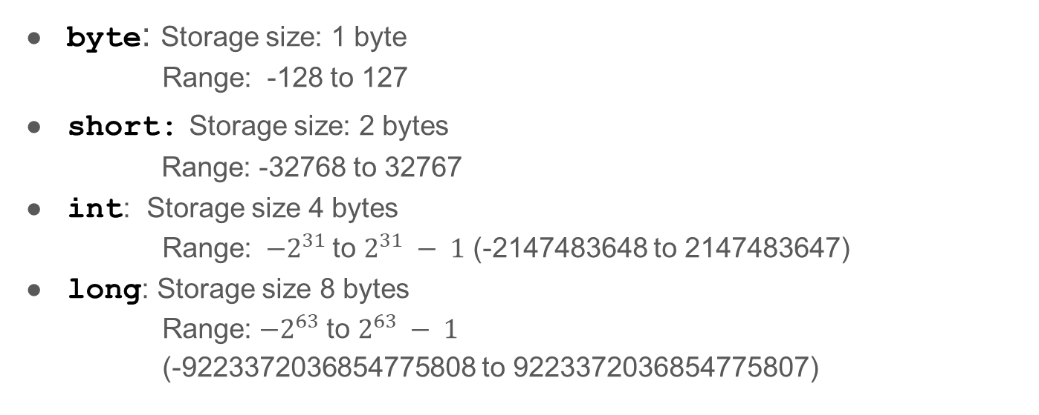
Java Integer Types:
byte: Storage size: 1 byte
Range: -128 to 127
short: Storage size: 2 bytes
Range: -32768 to 32767
int: Storage size 4 bytes
Range: $−2^{31}$to $2^{31} − 1$ (-2147483648 to 2147483647)
long: Storage size 8 bytes
Range: $−2^{63}$to $2^{63} − 1$
(-9223372036854775808 to 9223372036854775807)

Slide 14
Floating-Point Literals
Written with decimal point, by default treated as double type. Example: 5.0 is considered as a double value, not a float value.
We can make a number float by appending the letter f or F.
Example:
100.2f or 100.2F is float number
100.2d or 100.2D or 100.2 is a double number.

Slide 15
double vs. float
The double type values are more accurate than the float value.
Example:
System.out.println("1.0/3.0 is: " + 1.0/3.0);
Displays: 1.0/3.0 is: 0.3333333333333333
System.out.println("1.0F/3.0F is: " + 1.0F/3.0F);
Displays: 1.0F/3.0F is: 0.33333334
16 digits
8 digits

Slide 16
Scientific Notation
Floating-point literals can also be specified in scientific notations.
Example:
1.23456e+2, same as 1.23456e2, is equivalent to 123.456.
1.23456e-2 is equivalent to 0.0123456.
E (or e) represents an exponent and it can be either in lowercase or uppercase.

Slide 17
Real Numbers:
Float: 4 bytes
Negative range: -3.4028235E+38 to -1.4E-45
Positive range: 1.4E-45 to 3.4028235E+38
Double: 8 bytes
Negative range: -1.7976931348623157E+308 to -4.9E-324
Positive range: 4.9E-324 to 1.7976931348623157E+308

